Slide 1

Cosmir Home Apps Development
Designer : Kholil Akhmad
Lead Prog : M Afghan
Junior : Amelia A and Riswandy
Art and Sound : Anggraeni D, Tafana K dan
Anita Dewi S

Slide 2

Splash Screen

Slide 3


Home
Easy
Medium
Hard

Slide 4





















Level 1
10:10
123

Slide 5
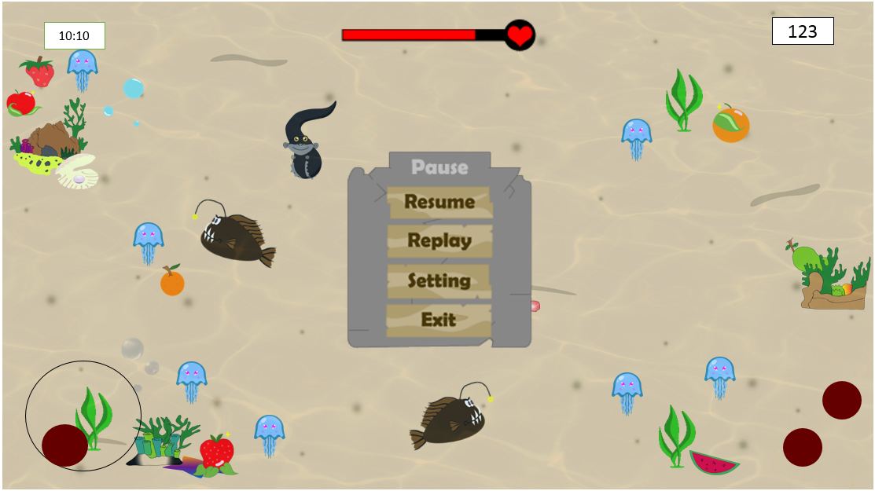
Pause

Slide 6


Level 2
10:10
123

Slide 7



Level 3
10:10
123

Slide 8
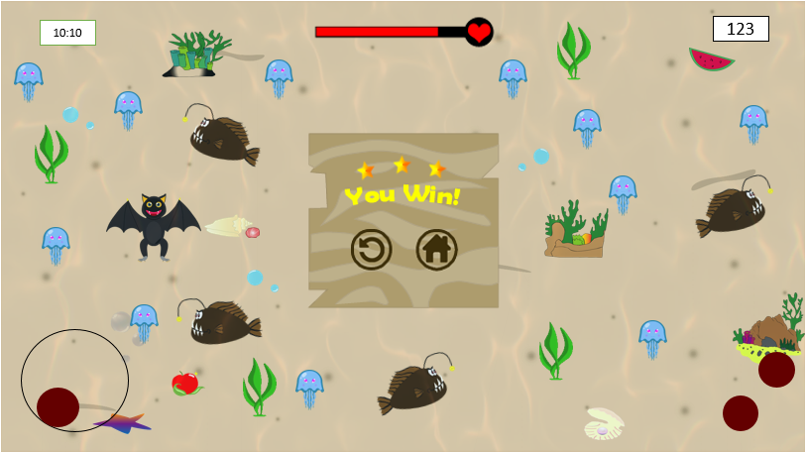
Ending

